Slide 1

Identification of multiple high leverage points in logistic regression
Dinghao Wang, Pengkun Liang
2019.12.06

Slide 2
1
Introduction
2
Traditional methods
3
New method
4
Comparisons
5
Conclusion

Slide 3
1
Introduction
In regression diagnostics the issue of outliers, influential observation and high leverage
points (HLP) are discussed together.

Slide 4

Some definitions
outliers
influential
an outlier is a point that deviates from the linear relationship determined from the other points, or at least from the majority of those points.
01
02
Observations whose presence or absence can make a huge impact on the fitting of the model and hence the resulting analyses are called influential
HLP
More about HLP
HLP are unusual observations in the X-space.
03
04
HLP greatly affect the fitted values and consequently its presence might cause all kind of interpretative problems such as erroneous goodness-of-fit statistics, wrong odds ratios, wrong Wald statistics, etc.

Slide 5
2
Traditional methods
Hoaglin and Welsch consider observations unusual when hi exceeds 2k/n which is also known as twice-the-mean (2M) rule. Vellman and Welsch suggest considering the thrice-the-mean (3M)

Slide 6
Some commonly used methods
2M&3M of leverage
01
This PPT template for the rice husk designer pencil demo works, focusing
单击编辑标题
04
This PPT template for the rice husk designer pencil demo works, focusing

Slide 7
New method(MDDM)
Identify suspect HLP
Omit suspect cases
Refit the model
Redo the DDM

Slide 8
请输入您的标题
2013
2014
2015
2019
20XX
单击添加标题
单击添加标题
单击添加标题
单击添加标题
单击添加标题
单击此处编辑内容，建议您在展示时采用微软雅黑字体
单击此处编辑内容，建议您在展示时采用微软雅黑字体
单击此处编辑内容，建议您在展示时采用微软雅黑字体
单击此处编辑内容，建议您在展示时采用微软雅黑字体
单击此处编辑内容，建议您在展示时采用微软雅黑字体

Slide 9
请输入您的标题
单击编辑标题
单击编辑标题
单击编辑标题
单击编辑标题
此处文字通过TXT文档或者QQ聊天窗口复制进入，无需调整格式，简单快捷，LEOPARD祝愿您汇报顺利！
此处文字通过TXT文档或者QQ聊天窗口复制进入，无需调整格式，简单快捷，LEOPARD祝愿您汇报顺利！
此处文字通过TXT文档或者QQ聊天窗口复制进入，无需调整格式，简单快捷，LEOPARD祝愿您汇报顺利！
此处文字通过TXT文档或者QQ聊天窗口复制进入，无需调整格式，简单快捷，LEOPARD祝愿您汇报顺利！
01
02
03
04

Slide 10
请输入您的标题
单击编辑标题
单击编辑标题
单击此处可编辑内容单击此处可编辑内容
01
关键词
单击此处可编辑内容单击此处可编辑内容
关键词
04
02
关键词
单击编辑标题
关键词
单击编辑标题
03
单击此处可编辑内容单击此处可编辑内容
单击此处可编辑内容单击此处可编辑内容

Slide 11
请输入您的标题
单击添加标题
单击添加标题
单击此处编辑内容，建议您在展示时采用微软雅黑字体
单击此处编辑内容，建议您在展示时采用微软雅黑字体
单击添加标题
单击添加标题
单击此处编辑内容，建议您在展示时采用微软雅黑字体
单击此处编辑内容，建议您在展示时采用微软雅黑字体

Slide 12
请输入您的标题
单击编辑标题
单击编辑标题
此处文字通过TXT文档或者QQ聊天窗口复制进入，无需调整格式，简单快捷，LEOPARD祝愿您汇报顺利！
此处文字通过TXT文档或者QQ聊天窗口复制进入，无需调整格式，简单快捷，LEOPARD祝愿您汇报顺利！
单击编辑标题
单击编辑标题
此处文字通过TXT文档或者QQ聊天窗口复制进入，无需调整格式，简单快捷，LEOPARD祝愿您汇报顺利！
此处文字通过TXT文档或者QQ聊天窗口复制进入，无需调整格式，简单快捷，LEOPARD祝愿您汇报顺利！
单击编辑标题
单击编辑标题
此处文字通过TXT文档或者QQ聊天窗口复制进入，无需调整格式，简单快捷，LEOPARD祝愿您汇报顺利！
此处文字通过TXT文档或者QQ聊天窗口复制进入，无需调整格式，简单快捷，LEOPARD祝愿您汇报顺利！

Slide 13
3
请输入您的标题
Applicable to enterprise introduction, summary
report, sales marketing, chart dataa

Slide 14
请输入您的标题
单击编辑标题
单击编辑标题
单击编辑标题
单击编辑标题
This PPT template for the rice husk designer pencil demo works, focusing on the production of high-end design templates, I hope to help your demonstration
This PPT template for the rice husk designer pencil demo works, focusing on the production of high-end design templates, I hope to help your demonstration
This PPT template for the rice husk designer pencil demo works, focusing on the production of high-end design templates, I hope to help your demonstration
This PPT template for the rice husk designer pencil demo works, focusing on the production of high-end design templates, I hope to help your demonstration

Slide 15
请输入您的标题
单击编辑标题
单击此处可编辑内容单击此处可编辑内容单击此处可编辑内容
单击编辑标题
单击此处可编辑内容单击此处可编辑内容单击此处可编辑内容
关键词
关键词
关键词
单击编辑标题
单击此处可编辑内容单击此处可编辑内容单击此处可编辑内容

Slide 16
请输入您的标题
单击编辑标题
单击编辑标题
单击编辑标题
单击编辑标题
此处文字通过TXT文档或者QQ聊天窗口复制进入，无需调整格式，简单快捷，LEOPARD祝愿您汇报顺利！
此处文字通过TXT文档或者QQ聊天窗口复制进入，无需调整格式，简单快捷，LEOPARD祝愿您汇报顺利！
此处文字通过TXT文档或者QQ聊天窗口复制进入，无需调整格式，简单快捷，LEOPARD祝愿您汇报顺利！
此处文字通过TXT文档或者QQ聊天窗口复制进入，无需调整格式，简单快捷，LEOPARD祝愿您汇报顺利！

Slide 17
请输入您的标题
01
This PPT template for the rice husk designer pencil demo works, focusing on the production of high-end design templates, I hope to help your demonstration
02
This PPT template for the rice husk designer pencil demo works, focusing on the production of high-end design templates, I hope to help your demonstration
03
This PPT template for the rice husk designer pencil demo works, focusing on the production of high-end design templates, I hope to help your demonstration

Slide 18
4
Comparisons
Compare different methods with original Brown data,
modified Brown data and artificial data

Slide 19
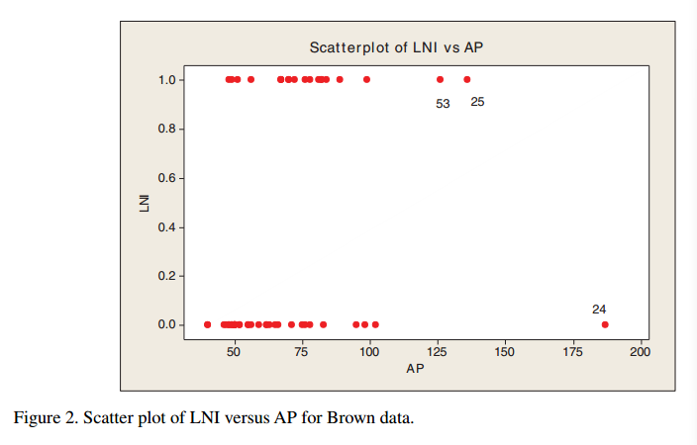
Original Brown data
Scatter plot
Identify suspect NO.24,25,53
Leverage (2M&3M)
Identify suspect NO.24,25,53
Commonly used DM
Author claimed: Identify suspect NO.24,25,53
New method DDM
Author claimed: Identify suspect NO.24,25,53

Slide 20
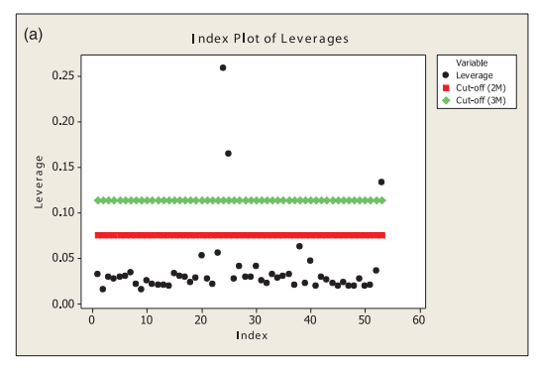
Original Brown data

Slide 21
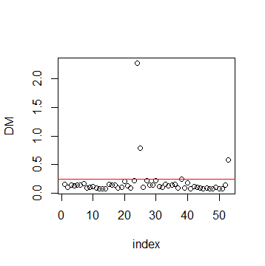
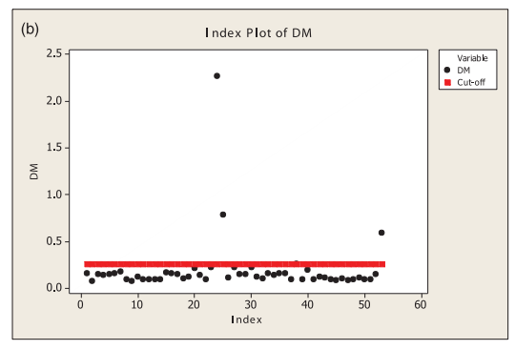
Original Brown data

Slide 22
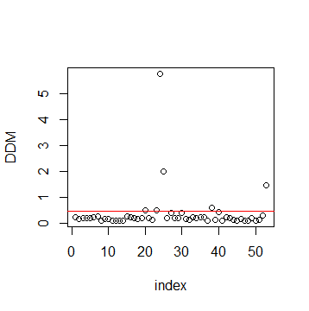
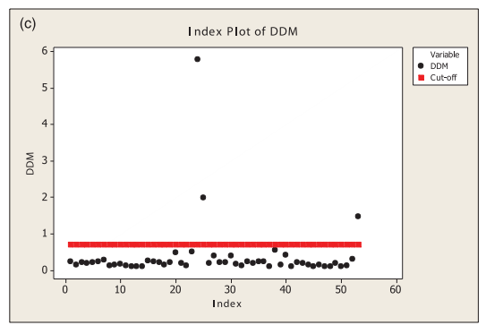
Original Brown data

Slide 23
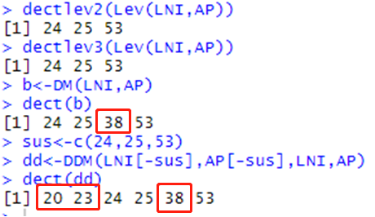
Original Brown data
Leverage (2M&3M)
Identify suspect NO.24,25,53
Commonly used DM
Author claimed: Identify suspect NO.24,25,53
New method DDM
Author claimed: Identify suspect NO.24,25,53

Slide 24
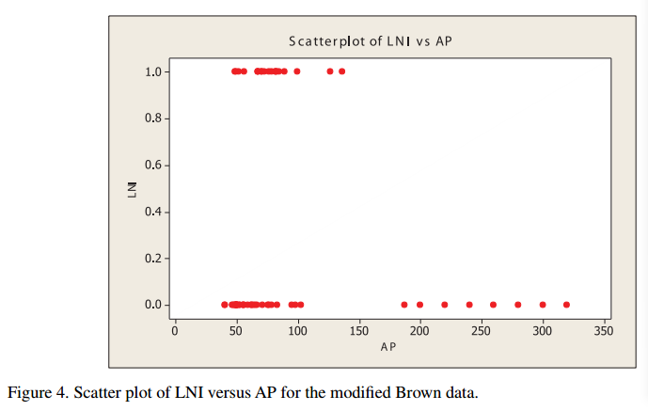
Modified Brown data
Scatter plot
Besides NO.24,25,53, we insert seven more HLP (cases 54 through 60)
Leverage (2M&3M)
2M: 54 ,55, 56 ,57, 58 ,59 ,60
3M: 56, 57, 58, 59, 60
Commonly used DM
Author claimed: correctly identifies nine HLP but fails to detect the case 53
New method DDM
Author claimed: identify all 10 HLP without swamping any low leverage cases

Slide 25
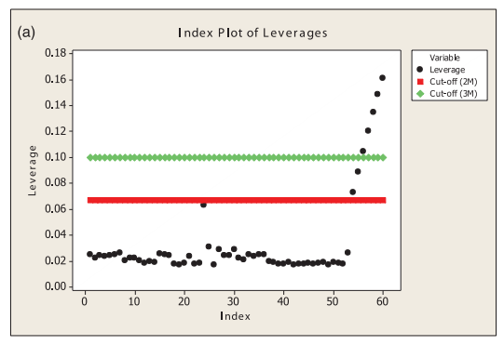
Modified Brown data

Slide 26
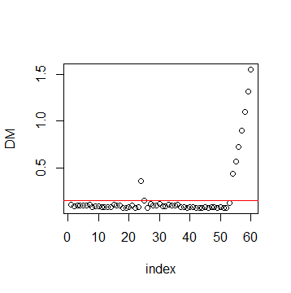
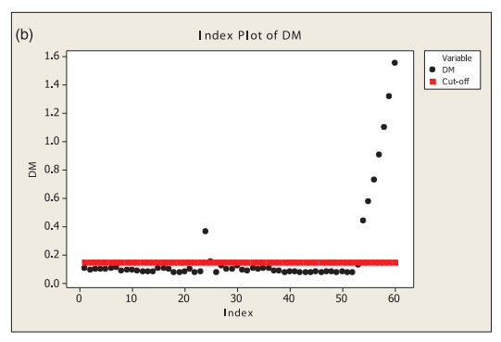
Modified Brown data

Slide 27
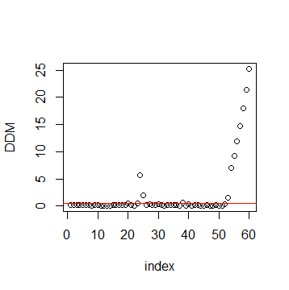
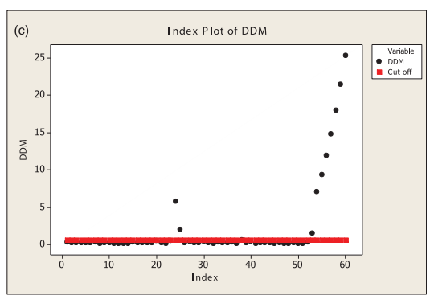
Modified Brown data

Slide 28
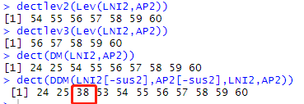
Modified Brown data
Leverage (2M&3M)
2M: 54 ,55, 56 ,57, 58 ,59 ,60
3M: 56, 57, 58, 59, 60
Commonly used DM
Author claimed: correctly identifies nine HLP(24,25,54~60) but fails to detect the case 53
New method DDM
Author claimed: identify all 10 HLP without swamping any low leverage cases(24,25,53~60)

Slide 29

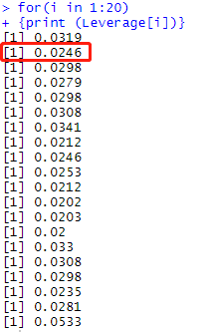

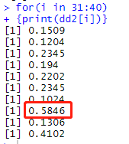
Several errors

Slide 30
5
Conclusions

Slide 31



development
01
Leverage (H)
For an extreme data point in the X-space, it is expected that the quantity π ˆi should be very close to 0 or 1
Hence even if the quantity bi is large, its corresponding hi could be very small making the procedure of identifying HLP on the magnitude of hi very cumbersome
DM
02
Imon suggested to obtain a suitable confidence bound type cut-off point for them
03
DDM
After the omission of suspect cases, the model is refitted with the rest of the data and the DDM values are computed for the entire data set

Slide 32
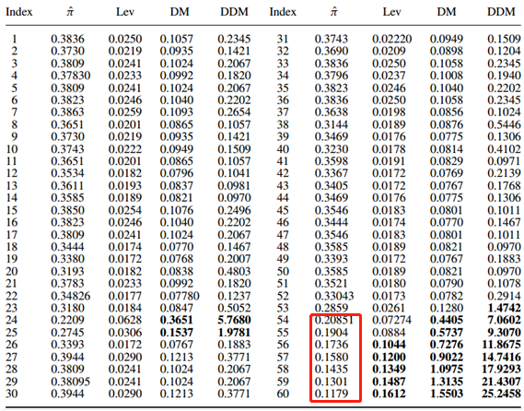
Improvement

Slide 33
Reference
[1] A.H.M. Rahmatullah Imon & Ali S. Hadi (2013) Identification of multiple high leverage points in logistic regression, Journal of Applied Statistics, 40:12, 2601-2616
[2] B.W. Brown, Jr, Prediction analysis for binary data, in Biostatistics Casebook, R.G. Miller, Jr, B. Efron, B. W.Brown, Jr, and L.E. Moses, eds., Wiley, New York, 1980, pp. 3–18.
[3] A.H.M.R. Imon, Identification of high leverage points in logistic regression, Pak. J. Stat. 22 (2006), pp. 147–156
[4] D. Pregibon, Logistic regression diagnostics, Ann. Stat. 9 (1981), pp. 705–724

Slide 34
Thanks !
Dinghao Wang, Pengkun Liang
2019.12.06

